Slide 1
Deploying Neural Network Models for Customer Churn Prediction

Slide 2
Agenda
Big Picture - Deep Learning Lifecycle
Azure Cloud services for Data Solutions
Deep Learning Architecture on Azure
Neural Network models
Understand NN Training and Deployment (Hands-on with Azure ML)

Slide 3
The Deep Learning Lifecycle
Monitor for bias, data drift, concept drift and model drift - alert and take action
Monitor
Process
Get data into the right form
Expose your model as an endpoint - which can be used by your stakeholders
DL
Lifecycle
Train a model using the data to classify, or detect
Deploy
Train
Evaluate your model’s performance - check accuracy, error rates
Evaluate
Tune
Perform hyper-parameter tuning on your model - enhance its performance

Slide 4







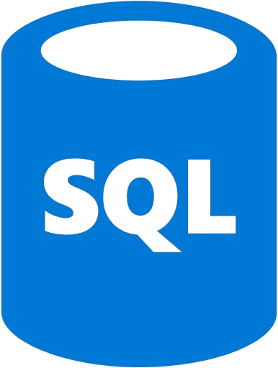




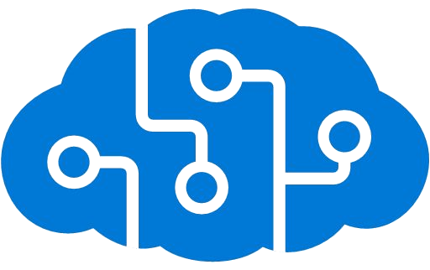
Azure Cloud services for Data Solutions
Data Lake
Storage
Engineering
Azure Data Factory
Blob Storage
Azure Cosmos
Azure Functions
Azure SQLDB
Analytics
AI and ML
Azure Synapse
Cognitive Services
Azure ML
Open AI Service

Slide 5

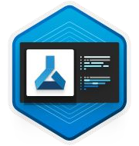



Deep Learning Architecture on Azure
Curated Environment
(fi. Ready-made environment 2. Dependencies)
Training Scripts
Blob Storage
AzureML GPU Cluster
Data
Blob Storage
Logs and Results
Submit Training Job
Azure ML Workspace

Slide 6
Neural Network (NN) Overview

Slide 7
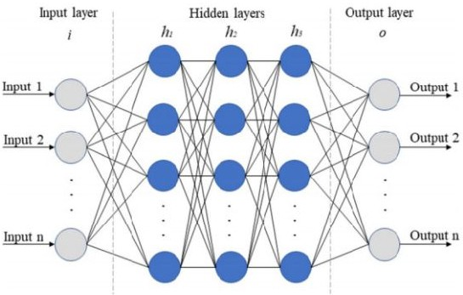
Basic NN Architecture

Slide 8

Convolutional Process

Slide 9
Pooling Process

Slide 10
Now let’s jump to - “Hands-On Training of Deep Learning Models in Azure ML Studio”

Slide 11

fi6

